Slide 1
Pop Sels for Everyone!
(Banner Population Selection and Letter Generation)
Presented by: Gina Goodwin
Programmer, Information and Technology Services
Arkansas State University-Jonesboro
October 2017

Slide 2
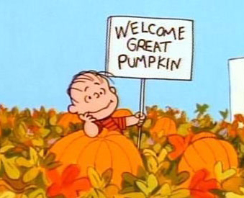
Introduction
Purpose
To gain an understanding of Banner Population Selection
and Letter Generation
Benefits
Learn validation/setup/procedure forms/pages
Learn how to create a Population Selection
Learn how to write a variable
Learn how to create a “letter”

Slide 3
Banner Basics
Who can use the process?
“G” General Form
What is Population Selection/ Letter Generation?
Definitions
Where is the data collected?
Tables (Behind the scenes)
When can I use the process?
Anytime
Why do I need this process?
- Information straight from Banner
How do I start the process?
Validation Forms/Pages
Set-up Forms/Pages
Procedure Forms/Pages

Slide 4
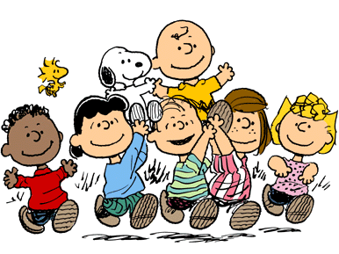
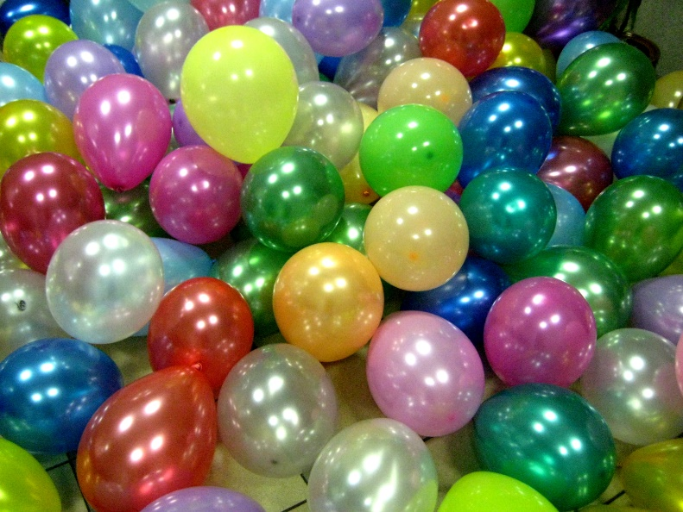
Population Selection

Slide 5
Population Selection
Forms {Banner 8} / Pages [Banner 9]
GLRSLCT (Population Selection Definition Rules Form) – Setup
GLISLCT (Population Selection Inquiry Form)
GURPDED (Data Element Dictionary Process)
GLIOBJT (Object Inquiry)
GLROBJT (Object Definition Rules)
GLBDATA (Population Selection Extract Process) – Procedure
GLIEXTR (Population Selection Extract Inquiry Form) - Results
GLAEXTR (Population Selection Extract Data Form) - Results

Slide 6
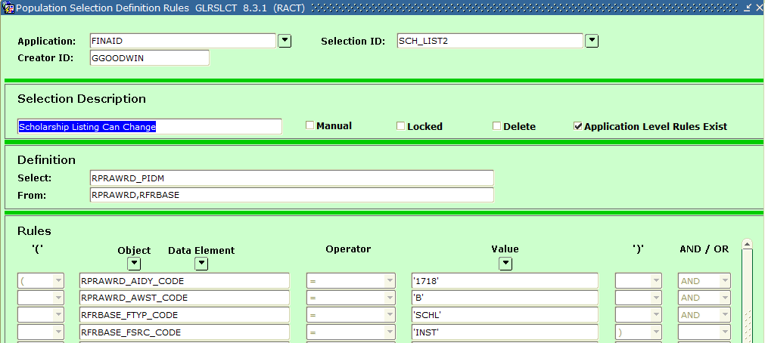
Population Selection
Forms {Banner 8}
GLRSLCT (Population Selection Definition Rules Form)

Slide 7
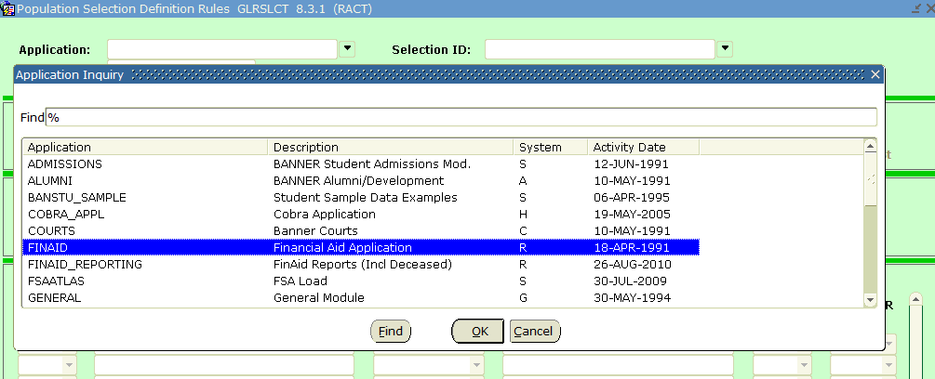
Population Selection
Forms {Banner 8}
GLRSLCT (Population Selection Definition Rules Form)

Slide 8
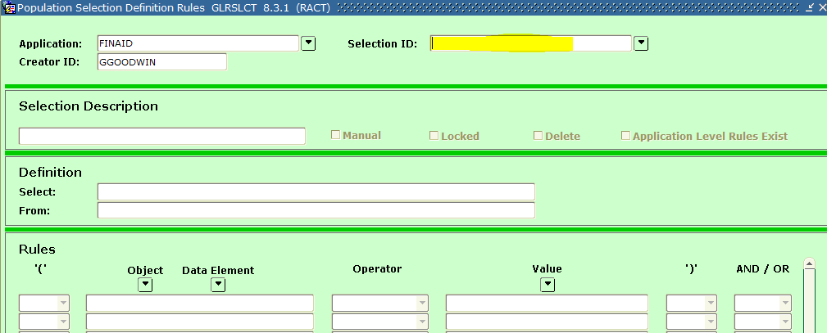
Population Selection
Forms {Banner 8}
GLRSLCT (Population Selection Definition Rules Form)

Slide 9
Population Selection
Forms {Banner 8}
GLISLCT (Population Selection Inquiry Form)

Slide 10
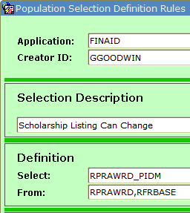
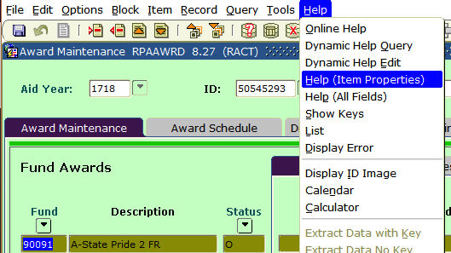
Population Selection
Forms {Banner 8}
GLRSLCT (Population Selection Definition Rules Form)

Slide 11
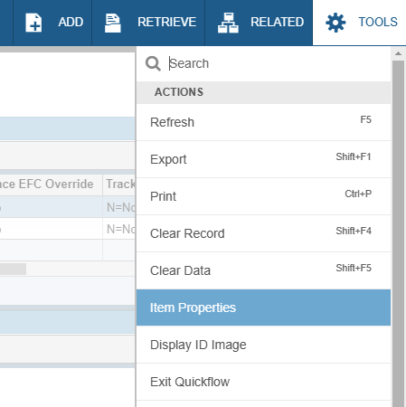
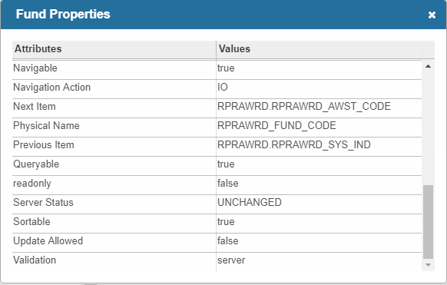
Population Selection
Pages [Banner 9]
GLRSLCT (Population Selection Definition Rules Form)

Slide 12
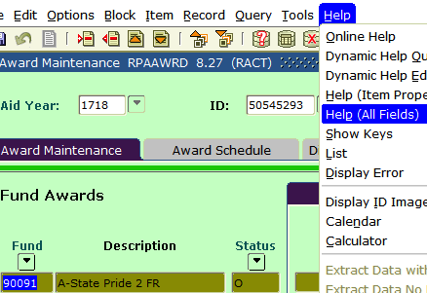
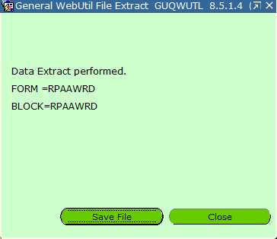
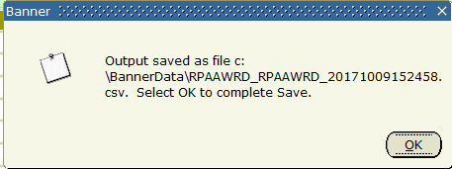
Population Selection
Forms {Banner 8}
GLRSLCT (Population Selection Definition Rules Form)

Slide 13
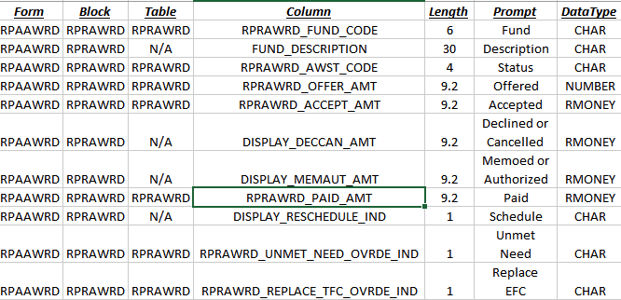
Population Selection
Forms {Banner 8}
GLRSLCT (Population Selection Definition Rules Form)

Slide 14
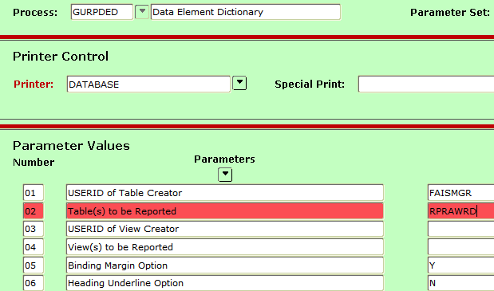
Population Selection
Forms {Banner 8}
GURPDED (Data Element Dictionary Process)

Slide 15
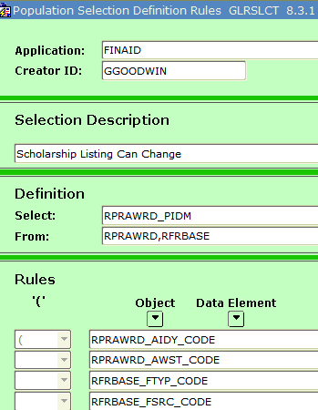
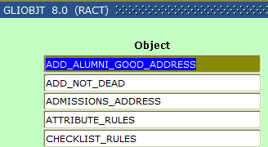
Population Selection
Forms {Banner 8}
GLIOBJT (Object Inquiry) & GLROBJT (Object Definition Rules)

Slide 16
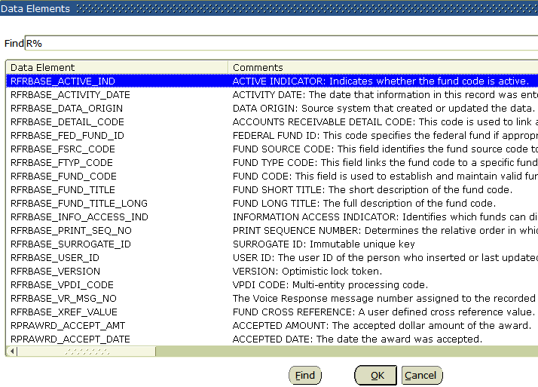
Population Selection
Forms {Banner 8}
GLRSLCT (Population Selection Definition Rules Form)

Slide 17
Population Selection
Forms {Banner 8}
GLRSLCT (Population Selection Definition Rules Form)

Slide 18
Population Selection
Forms {Banner 8}
GLRSLCT (Population Selection Definition Rules Form)

Slide 19
Population Selection
Forms {Banner 8}
GLRSLCT (Population Selection Definition Rules Form)
I got a rock.

Slide 20
Population Selection
Forms {Banner 8}
GLBDATA (Population Selection Extract Process)

Slide 21
Population Selection
Forms {Banner 8}
GLBDATA (Population Selection Extract Process)

Slide 22
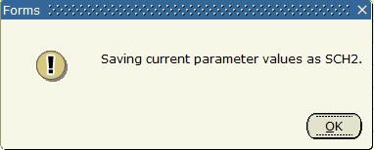
Population Selection
Forms {Banner 8}
GLBDATA (Population Selection Extract Process)

Slide 23
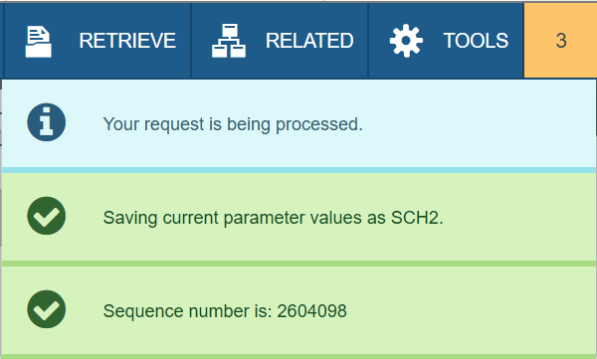
Population Selection
Pages [Banner 9]
GLBDATA (Population Selection Extract Process)

Slide 24
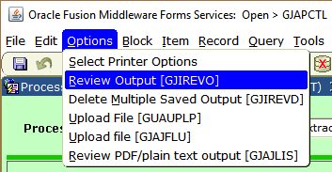
Population Selection
Forms {Banner 8}
GLBDATA (Population Selection Extract Process)

Slide 25
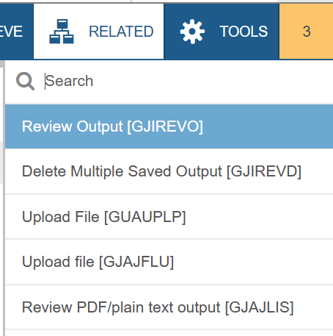
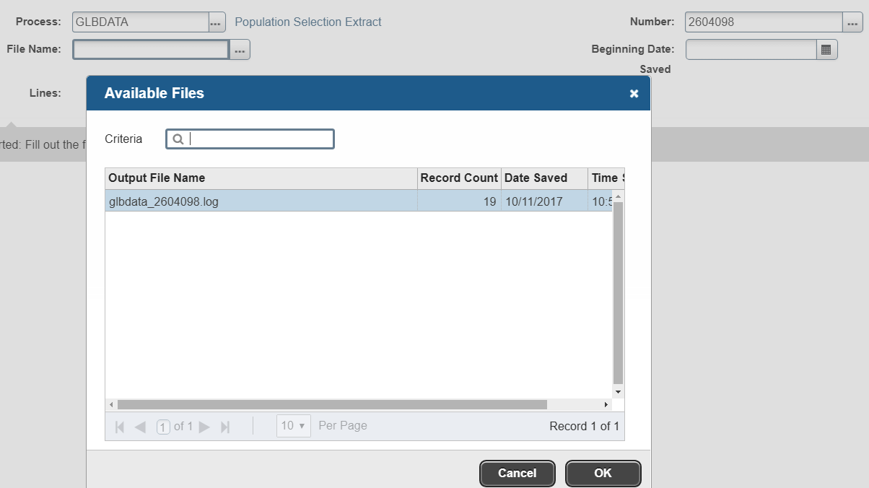
Population Selection
Pages [Banner 9]
GLBDATA (Population Selection Extract Process)

Slide 26
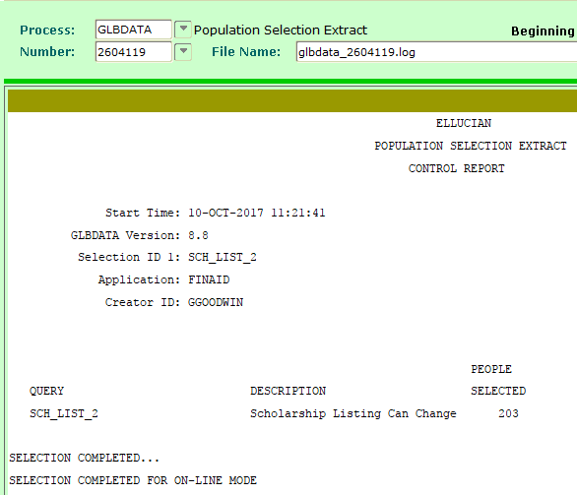
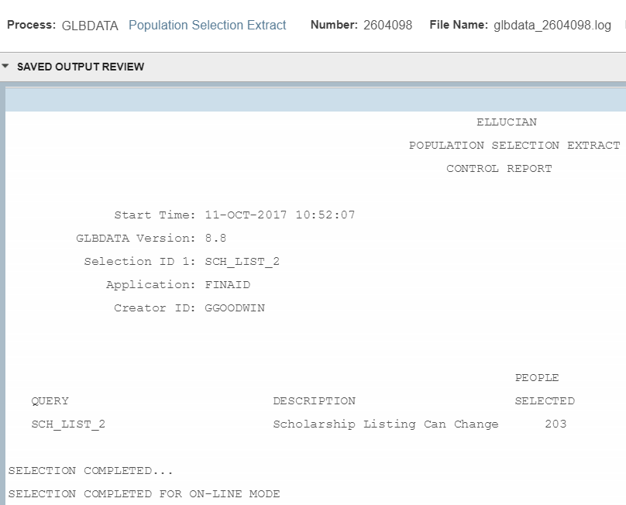
Population Selection
Forms {Banner 8} / Pages [Banner 9]
GLBDATA (Population Selection Extract Process)

Slide 27
Population Selection
Forms {Banner 8}
GLIEXTR (Population Selection Extract Inquiry Form)

Slide 28
Population Selection
Forms {Banner 8}
GLAEXTR (Population Selection Extract Data Form)

Slide 29
Population Selection
Forms {Banner 8}
GLBDATA (Population Selection Extract Process)

Slide 30
Population Selection
Forms {Banner 8}
GLBDATA (Population Selection Extract Process)
UNION = INTERSECT =
MINUS =
Pop Sel 1
Pop Sel 2
Pop Sel 1
Pop Sel 2
Pop Sel 1
Pop Sel 2

Slide 31
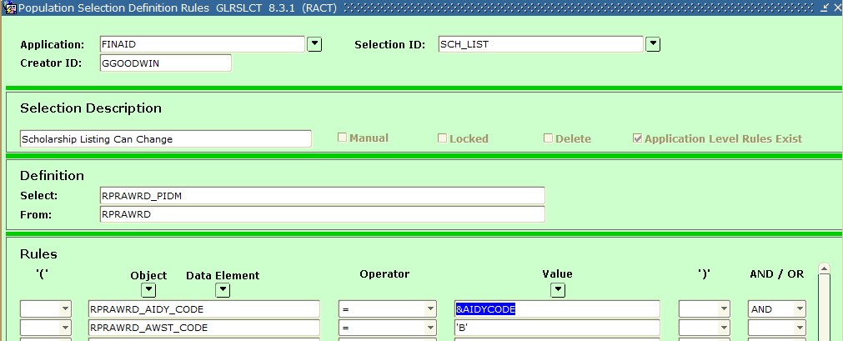
Population Selection
Forms {Banner 8}
GLRSLCT (Population Selection Definition Rules Form)

Slide 32
Population Selection
Forms {Banner 8}
GLBDATA (Population Selection Extract Process)

Slide 33
Population Selection
Forms {Banner 8} / Pages [Banner 9]
GLRSLCT (Population Selection Definition Rules Form) – Setup
GLISLCT (Population Selection Inquiry Form)
GURPDED (Data Element Dictionary Process)
GLIOBJT (Object Inquiry)
GLROBJT (Object Definition Rules)
GLBDATA (Population Selection Extract Process) – Procedure
GLIEXTR (Population Selection Extract Inquiry Form) - Results
GLAEXTR (Population Selection Extract Data Form) - Results

Slide 34
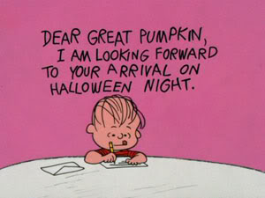
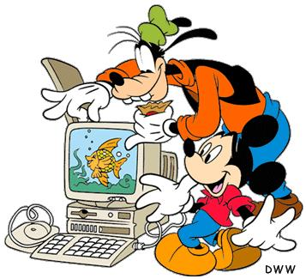
Letter Generation

Slide 35
Letter Generation
Forms {Banner 8} / Pages [Banner 9]
Validation Forms
GTVPARA (Paragraph Code Validation)
GTVLETR (Letter Code Validation)
Set-up Forms
GLRVRBL (Variable Rules Definition)
GLIVRBL (Variable Inquiry)
GUAPARA (Paragraph)
GUALETR (Letter Process)
Procedure Forms
GLBLSEL (Letter Extract Process)
GLRLETR (Letter Generation Print Report)

Slide 36
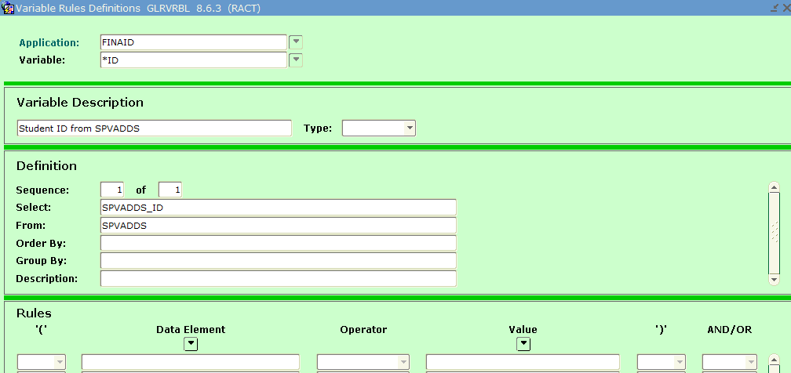
Letter Generation
Forms {Banner 8}
GLRVRBL (Variable Rules Definition)

Slide 37
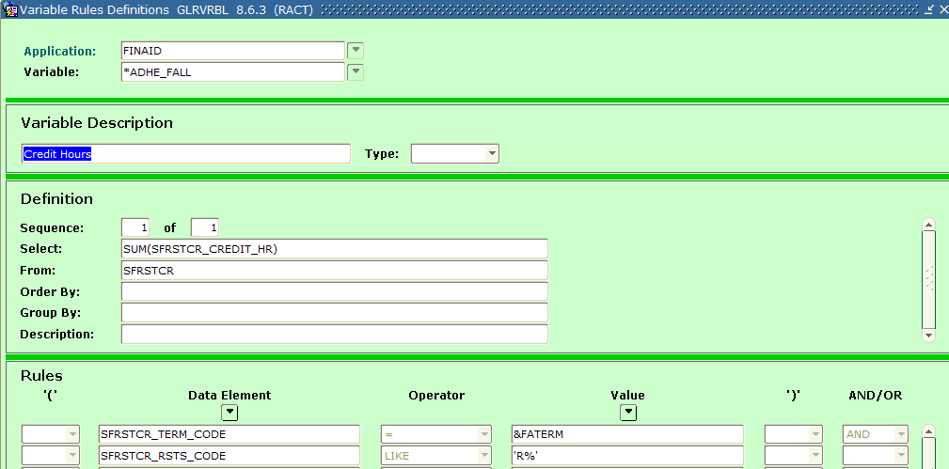
Letter Generation
Forms {Banner 8}
GLRVRBL (Variable Rules Definition)

Slide 38
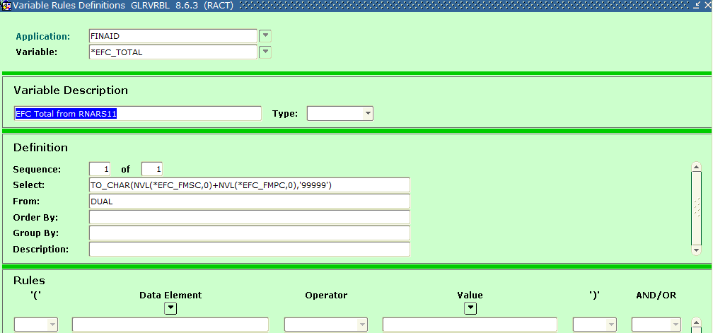
Letter Generation
Forms {Banner 8}
GLRVRBL (Variable Rules Definition)

Slide 39
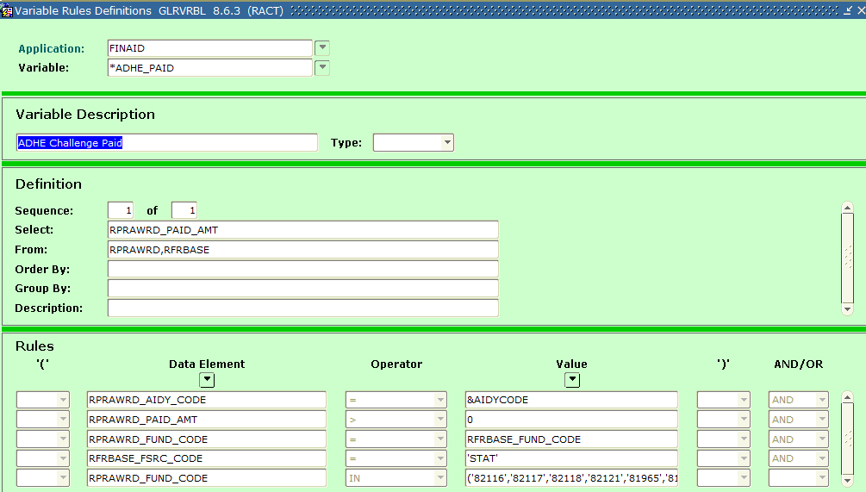
Letter Generation
Forms {Banner 8}
GLRVRBL (Variable Rules Definition)

Slide 40
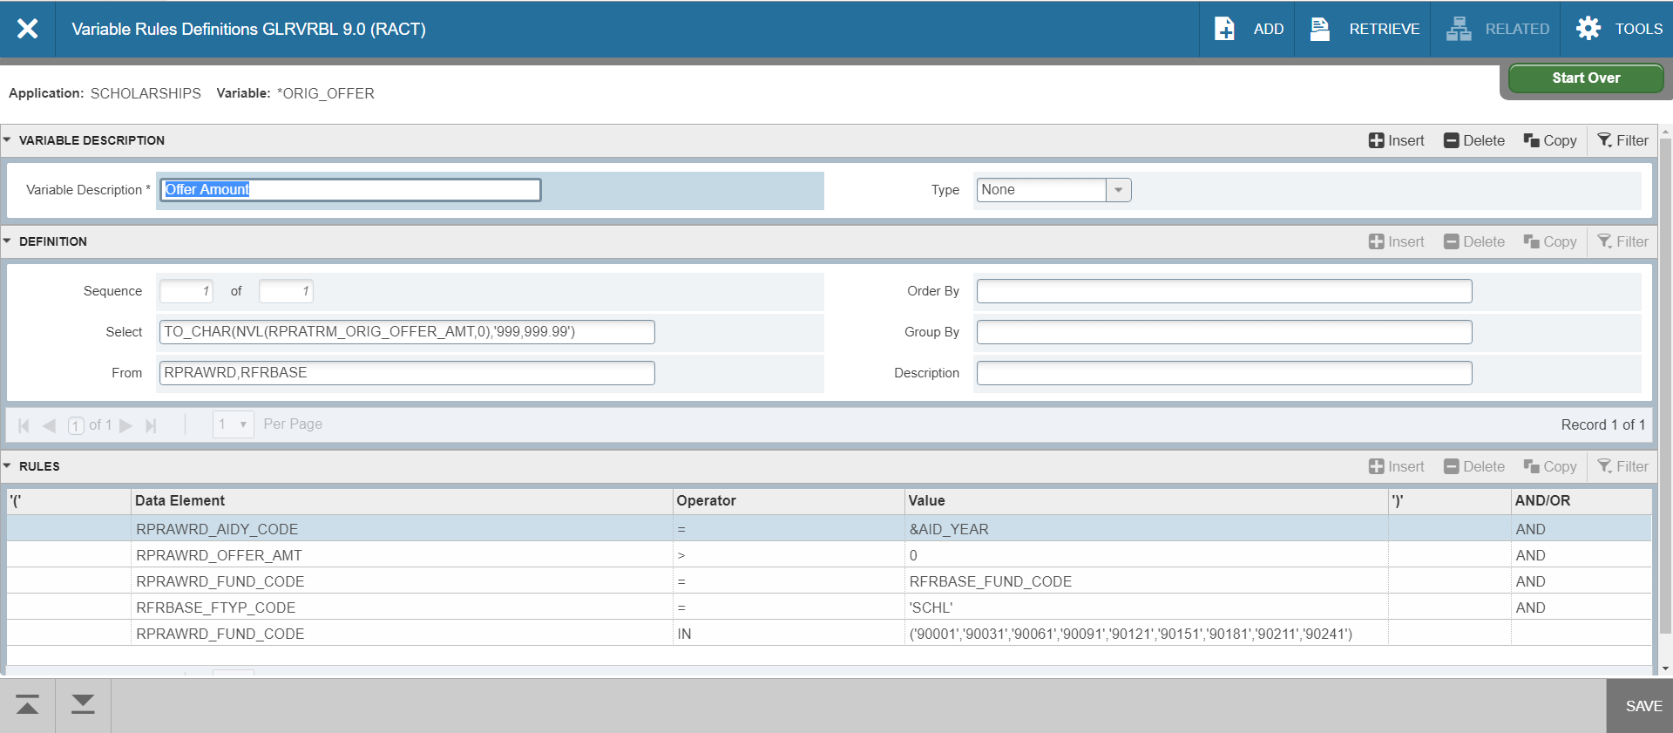
Letter Generation
Page [Banner 9]
GLRVRBL (Variable Rules Definition)

Slide 41
Letter Generation
Forms {Banner 8}
GTVPARA (Paragraph Code Validation)

Slide 42
Letter Generation
Forms {Banner 8}
GUAPARA (Paragraph)

Slide 43
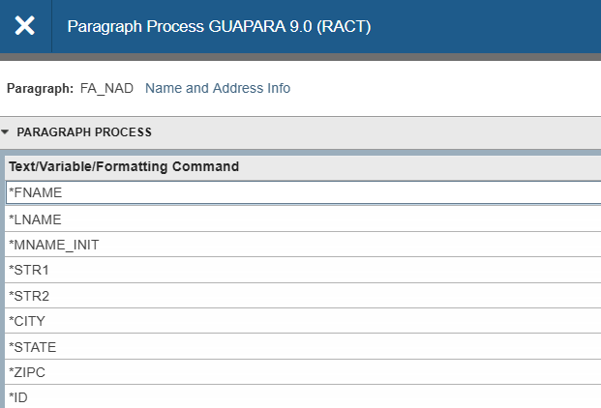
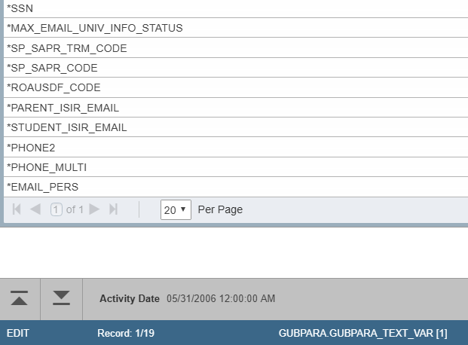
Letter Generation
Forms [Banner 9]
GUAPARA (Paragraph)

Slide 44
Letter Generation
Forms {Banner 8}
GTVLETR (Letter Code Validation)

Slide 45
Letter Generation
Forms {Banner 8}
GUALETR (Letter Process)

Slide 46
Letter Generation
Pages [Banner 9]
GUALETR (Letter Process)

Slide 47
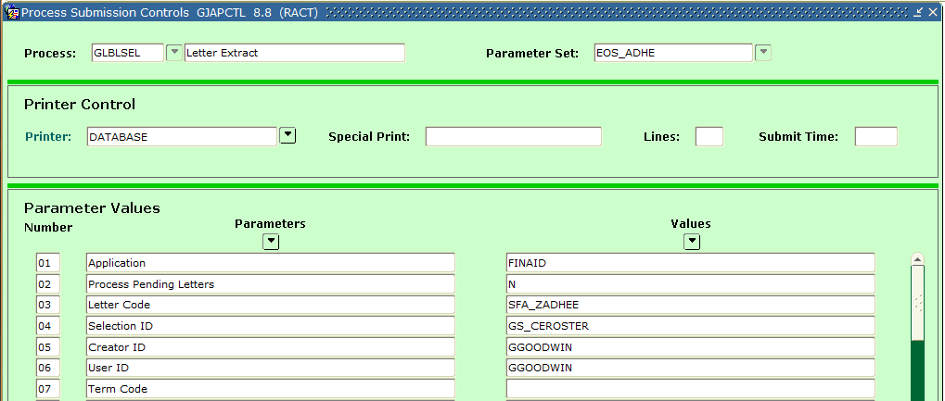
Letter Generation
Forms {Banner 8}
GLBLSEL (Letter Extract Process)

Slide 48
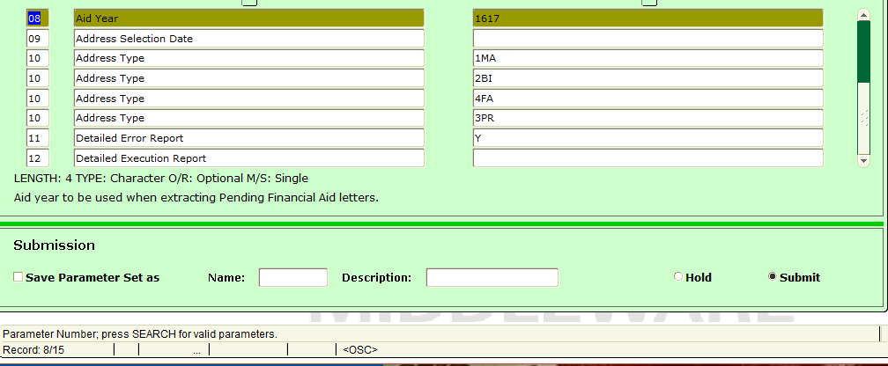
Letter Generation
Forms {Banner 8}
GLBLSEL (Letter Extract Process)

Slide 49
Letter Generation
Forms {Banner 8}
GLBLSEL (Letter Extract Process)

Slide 50
Letter Generation
Pages [Banner 9]
GLBLSEL (Letter Extract Process)

Slide 51
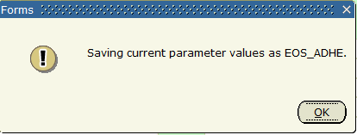
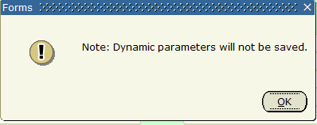
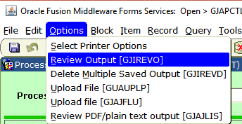
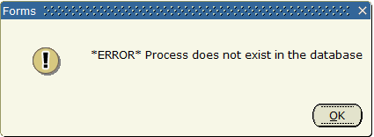
Letter Generation
Forms {Banner 8}
GLBLSEL (Letter Extract Process)

Slide 52
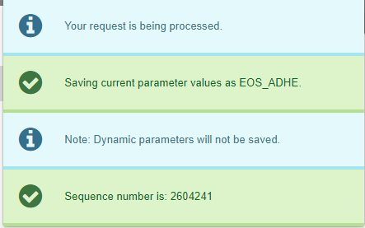
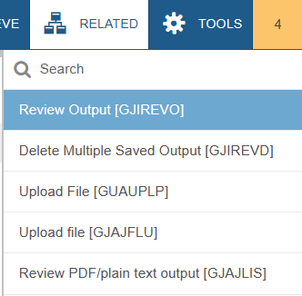
Letter Generation
Pages [Banner 9]
GLBLSEL (Letter Extract Process)

Slide 53
Letter Generation
Forms {Banner 8}
GLBLSEL (Letter Extract Process)

Slide 54
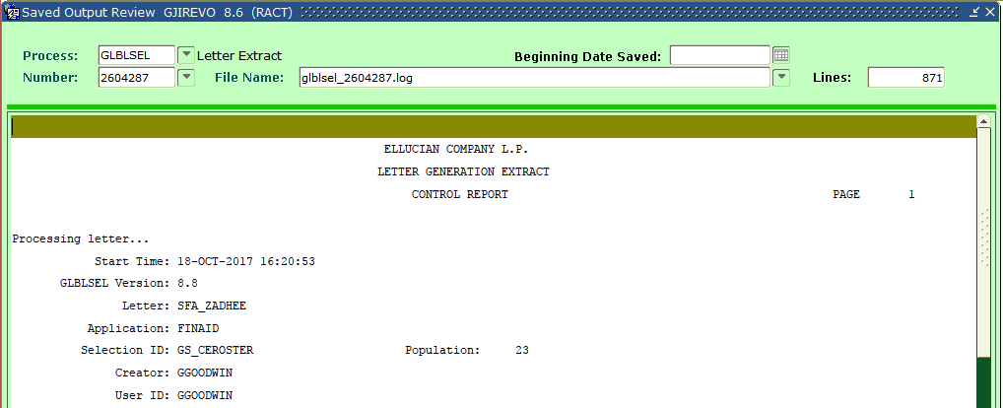
Letter Generation
Forms {Banner 8}
GLBLSEL (Letter Extract Process)

Slide 55
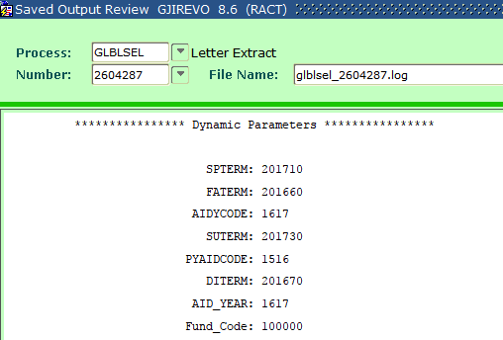
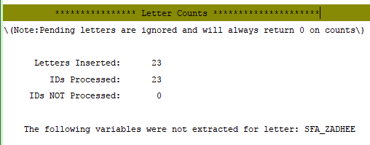
Letter Generation
Forms {Banner 8}
GLBLSEL (Letter Extract Process)

Slide 56
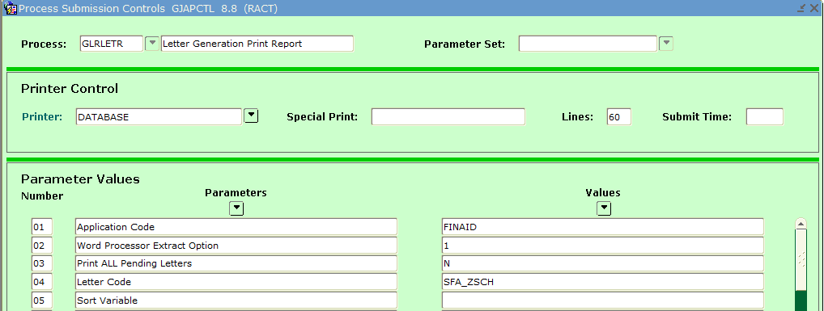
Letter Generation
Forms {Banner 8}
GLRLETR (Letter Generation Print Report)

Slide 57
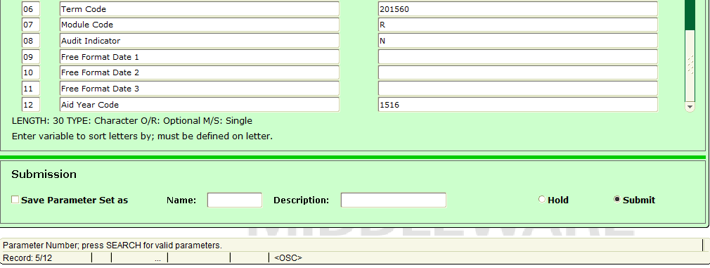
Letter Generation
Forms {Banner 8}
GLRLETR (Letter Generation Print Report)

Slide 58
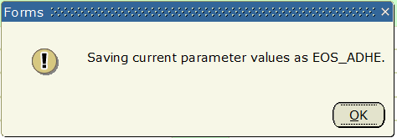
Letter Generation
Forms {Banner 8}
GLRLETR (Letter Generation Print Report)

Slide 59
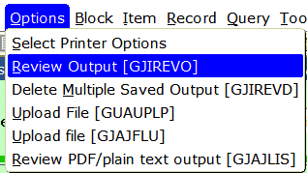
Letter Generation
Forms {Banner 8}
GLRLETR (Letter Generation Print Report)

Slide 60
Letter Generation
Forms {Banner 8}
GLRLETR (Letter Generation Print Report)

Slide 61
Letter Generation
Pages [Banner 9]
GLRLETR (Letter Generation Print Report)

Slide 62
Letter Generation
Forms {Banner 8}
GLRLETR (Letter Generation Print Report)

Slide 63
Letter Generation
Forms {Banner 8}
GLRLETR (Letter Generation Print Report)

Slide 64
Letter Generation
Forms {Banner 8} / Pages [Banner 9]
Validation Forms
GTVPARA (Paragraph Code Validation)
GTVLETR (Letter Code Validation)
Set-up Forms
GLRVRBL (Variable Rules Definition)
GLIVRBL (Variable Inquiry)
GUAPARA (Paragraph)
GUALETR (Letter Process)
Procedure Forms
GLBLSEL (Letter Extract Process)
GLRLETR (Letter Generation Print Report)

Slide 65
Conclusion
Population Selections
Forms {Banner 8} / Pages [Banner 9]
Set up
Procedure
Results
Letter Generation
Forms {Banner 8} / Pages [Banner 9]
Validation
Set up
Procedure
Results
Examples

Slide 66
Finale
Questions

Slide 67
Pop Sels for Everyone!
(Banner Population Selection and Letter Generation)
Presented by: Gina Goodwin
E-mail: ggoodwin@astate.edu
Programmer, Information and Technology Services
Arkansas State University-Jonesboro
October 2017

